Slide 1
A Survey of South American Lizards Biodiversity and Ecological

Slide 2
Introduction
***START OF PAGE 2*** Introduction: South America, known for its breathtaking landscapes and rich biodiversity, is a haven for a vast array of lizard species. These reptilian inhabitants contribute significantly to the continent's intricate ecosystems, playing vital ecological roles that influence plant and insect populations, serve as prey for predators, and contribute to overall ecosystem balance. In this comprehensive research, we delve into the fascinating world of South American lizards, exploring the diverse families that call this continent home. Our study focuses on three remarkable lizard species - the Green Iguana (Iguana iguana), the Caiman Lizard (Dracaena guianensis), and the Tepui Lizard (Pristidactylus urichi) - highlighting their unique characteristics, habitats, and ecological significance. Additionally, we delve into the threats these lizards face and examine the conservation efforts in place to protect these captivating reptiles and ensure the preservation of their essential roles within South American ecosystems. Through this exploration, we hope to gain a deeper understanding of the importance of these reptilian inhabitants, encouraging further research and conservation initiatives to safeguard their future and the biodiversity they contribute to the magnificent continent of South America. Biodiversity and Distribution of South American Lizards: South America is home to a diverse range of lizard families, each with its unique characteristics and adaptations to the various habitats found across the continent. Some of the prominent lizard families in South America include: 1. Iguanidae: This family includes the iconic Green Iguana (Iguana iguana), which is one of the most well-known and widespread lizards in the region. Iguanidae comprises a variety of species, and its members are often arboreal, with long tails, strong limbs, and a herbivorous diet. 2. Teiidae: The Teiidae family is commonly referred to as "whiptails" or "racerunners." These lizards are known for their slender bodies, long tails, and quick movements. A famous member of this family is the Tegu (Tupinambis spp.), a large and intelligent lizard frequently kept as a pet. 3. Gymnophthalmidae: This family is composed of small, slender lizards often found in forested regions. They are characterized by their reduced limbs and elongated bodies, and they play essential roles in insect control within their ecosystems. 4. Gekkonidae: Geckos are representatives of the Gekkonidae family in South America. These lizards are typically nocturnal, with adhesive toe pads that allow them to climb vertical surfaces with ease. The Gold Dust Day Gecko (Phelsuma laticauda) is an example of a gecko species found in certain parts of South America. 5. Sphaerodactylidae: The Sphaerodactylidae family consists of small geckos known as "dwarf geckos." These miniature lizards are often found in leaf litter and rocky areas, displaying a remarkable range of coloration and patterns. ***END OF PAGE 2***

Slide 3
Dactyloidae The Anoles are members of the Dactyloidae family and several species inhabit
***START OF PAGE 3*** 6. Dactyloidae: The Anoles are members of the Dactyloidae family, and several species inhabit South America. They are characterized by their ability to change color and the presence of a dewlap, a colorful flap of skin used in communication and courtship displays. 7. Leiosauridae: This family comprises various "perching lizards" found across South America. They are typically diurnal and often seen basking in the sun on rocks and branches. 8. Polychrotidae: Another family containing the anole lizards, Polychrotidae includes several species that inhabit South America's tropical and subtropical regions. These are just a few examples of the diverse lizard families found in South America. Each family plays a distinct ecological role in its respective habitat, contributing to the rich biodiversity of the continent. Representative Species: Describe notable lizard species from different families found in South America, including but not limited to the following examples: 4.1. Green Iguana (Iguana iguana): The Green Iguana (Iguana iguana) is a fascinating lizard species found predominantly in Central and South America, known for its vibrant green coloration and impressive size. With an average length of 1.5 to 1.8 meters, including the tail, it is one of the largest lizard species in its range. The Green Iguana is primarily arboreal, spending much of its time in the treetops to avoid predators and search for its herbivorous diet, consisting of leaves, flowers, and fruits. This adaptable reptile has also managed to colonize urban areas, where it can be seen basking in the sun on fences or tree branches. Despite its popularity in the pet trade, the Green Iguana faces conservation concerns due to habitat loss and poaching. Understanding the ecological significance of this species and promoting responsible pet ownership are crucial steps in safeguarding the future of the Green Iguana and its vital role in the ecosystems it inhabits. 4.2. Caiman Lizard (Dracaena guianensis): The Caiman Lizard (Dracaena guianensis) is a captivating reptile native to the tropical regions of South America, particularly found in the Amazon Basin and its surrounding areas. This semi- aquatic species possesses a unique set of features, making it stand out among its lizard counterparts. One of its most distinctive characteristics is the serrated tail, which aids in swimming and serves as a defense mechanism against potential predators. The Caiman Lizard is ***END OF PAGE 3***

Slide 4
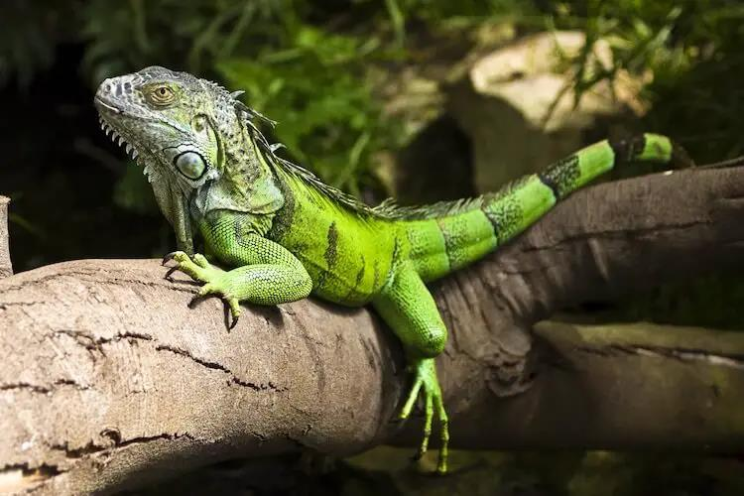

Slide 5
welladapted to a semiaquatic lifestyle spending
***START OF PAGE 4*** well-adapted to a semi-aquatic lifestyle, spending much of its time in and around slow-moving rivers and streams. Its diet primarily consists of aquatic vegetation, such as aquatic plants and fruits that grow near water bodies. As an essential component of riverine ecosystems, the Caiman Lizard plays a vital role in controlling aquatic vegetation and maintaining the ecological balance. However, like many other reptiles in the region, the Caiman Lizard faces threats such as habitat destruction and illegal trade. Consequently, conservation efforts are crucial to preserving this fascinating lizard species and its critical role in the delicate ecosystems it calls home. 4.3. Tepui Lizard (Pristidactylus urichi): The Tepui Lizard (Pristidactylus urichi) is a captivating and unique reptile inhabiting the Tepui plateaus of South America. These highland plateaus, characterized by sheer cliffs and isolated habitats, provide an extraordinary environment for the Tepui Lizard to thrive. The species has developed remarkable adaptations to its specific surroundings, such as its coloration, which often matches the rocks and vegetation of its habitat, offering camouflage from potential predators. Tepui Lizards have elongated limbs and digits that enable them to navigate the rocky terrain with ease. They are insectivorous, primarily feeding on insects and other small invertebrates found within their ecosystem. Due to the remoteness of their habitat and the unique conditions of the Tepui plateaus, these lizards have limited ranges, making them ecologically significant as potential indicators of the overall health and stability of these isolated ecosystems. Despite these intriguing characteristics, the Tepui Lizard remains relatively understudied, emphasizing the importance of further research to gain insights into the species' biology and ecology for conservation purposes and to appreciate its role in these enigmatic highland habitats. Threats and Conservation: The Green Iguana, Caiman Lizard, and Tepui Lizard all face various threats that impact their survival and well-being. Habitat loss due to deforestation, urbanization, and agriculture development is a common threat shared among these species. The Green Iguana is additionally affected by the illegal pet trade, which leads to population declines in the wild. For the Caiman Lizard, pollution and degradation of its aquatic habitats pose significant risks, while the Tepui Lizard faces challenges from the potential impacts of climate change on its highland ecosystem. ***END OF PAGE 4***

Slide 6
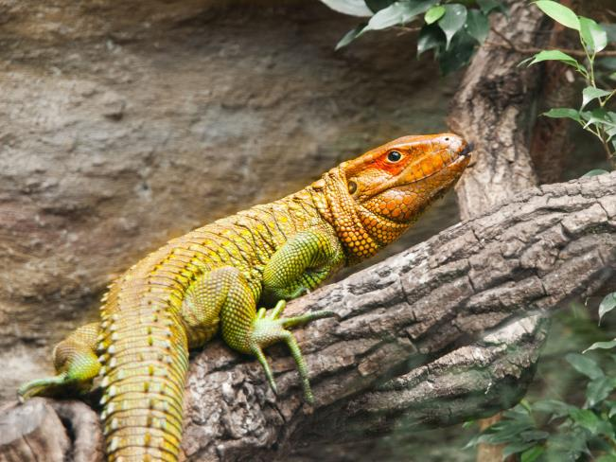

Slide 7
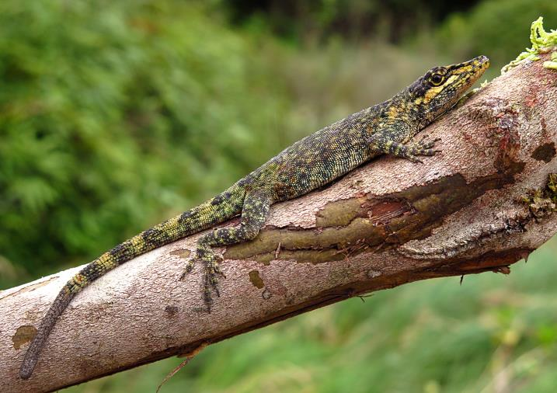

Slide 8
Furthermore habitat fragmentation restricts their movements and limits access to essential
***START OF PAGE 5*** Furthermore, habitat fragmentation restricts their movements and limits access to essential resources. Conservation efforts are essential to safeguarding these South American lizards. To address habitat loss, protected areas and reserves can be established to preserve crucial habitats for these reptiles. Conservation organizations can work to combat illegal pet trade, raising awareness about the importance of keeping these lizards in their natural environments and promoting responsible pet ownership. Efforts to minimize pollution and protect aquatic habitats will benefit the Caiman Lizard's survival. Additionally, research on the effects of climate change on the Tepui Lizard's habitat can guide conservation strategies to mitigate its impacts. Community involvement, education, and collaboration with local stakeholders are also essential components of successful conservation initiatives, ensuring the long-term protection of these captivating lizard species and the biodiversity they contribute to South American ecosystems. Ecological Roles: South American lizards play crucial ecological roles within their respective habitats, contributing significantly to the overall balance and health of their ecosystems. One of the primary roles of lizards, including the Green Iguana, Caiman Lizard, and Tepui Lizard, is insect control. As voracious insectivores, they help regulate insect populations, preventing potential outbreaks that could disrupt the ecosystem. Moreover, some lizards contribute to seed dispersal by ingesting fruits and seeds and then transporting them to new locations, aiding in plant propagation and maintaining biodiversity. Additionally, lizards serve as a vital link in the food chain, providing prey for various predators, including birds of prey, snakes, and mammals. Their presence supports the ecological balance of these diverse ecosystems, where they inhabit various niches, ranging from arboreal canopies to aquatic environments. As such, conserving South American lizard populations is not only essential for their own well-being but also critical for the overall health and stability of the intricate ecosystems they call home. Conclusion: In conclusion, our exploration of South American lizards has shed light on the fascinating and diverse world of these captivating reptiles. From the arboreal splendor of the Green Iguana to the semi-aquatic grace of the Caiman Lizard and the unique adaptations of the Tepui Lizard to its highland habitat, each species contributes its own distinct ecological significance to the continent's rich biodiversity. We have learned about the critical roles these lizards play in their respective ecosystems, from insect control to seed dispersal, acting as vital components in the intricate web of life. However, we also discovered that these remarkable creatures face numerous threats, such as habitat loss, climate change, and illegal trade, which necessitate urgent conservation efforts. Through responsible research, education, and community involvement, we can work towards protecting the habitats and promoting the welfare of these reptilian inhabitants. Conservation initiatives and the establishment of protected areas will ensure the preservation of their natural environments, safeguarding their future and the delicate balance they maintain within South American ecosystems. ***END OF PAGE 5***

Slide 9
As we embark on a journey of understanding and safeguarding these extraordinary reptiles let
***START OF PAGE 6*** As we embark on a journey of understanding and safeguarding these extraordinary reptiles, let us recognize the value they bring to the continent's natural heritage and ecological stability. By appreciating and conserving South American lizards, we not only preserve their diversity but also uphold the integrity of these delicate ecosystems and their contributions to the world's irreplaceable biodiversity. The continuous efforts to protect and cherish these reptilian treasures will leave a lasting legacy for generations to come, ensuring that the enchanting world of South American lizards remains a vital and cherished part of our planet's natural heritage. ***END OF PAGE 6***

